Slide 1
Building a
Better
Women’s Ministries b
Notes:
(CLICK)

Slide 2

Presented by:
# 0012012
NAD Ministries Project
Notes:
I am glad to be here with you today. I was raised in the Mackinac area of Northern Michigan in a little place that my Dad said wasn’t the end of the world, but you could see it from there. I grew up on a farm and was blessed to have a wonderful and very carefree childhood. I did have to do chores and work in the garden every day in the spring and summer, and help my mom can and freeze for winter but a lot of the time, my cousins and I roamed the 80 acres of woods adjacent to our farm and in the winter when we had 5 feet of snow on the level most of the time, we sledded and tobogganed, skated and skied to our hearts content.
I am a fifth generation Adventist and proud to have a nephew who is a Pastor in Washington state and he has two sons, so now there are 7 generations of Adventists in our family.
My husband Julian and I were married for 34 years before he passed away a little over a year ago. I am a nurse by profession, a woman, a sister, a wife and a mother to 20 “daughters of my heart”. I don’t know everything about Women’s Ministries, and I’m not the ultimate authority, but I do know that though I have had a number of jobs, from Pediatric Nurse to planning and setting up a Coronary Care unit to running my husband’s business for more than 25 years; that of everything I’ve done, being in Women’s Ministries is the most soul-satisfying thing of all. We are going to have fun this afternoon, learning about the tools that make Women’s Ministries work better. (CLICK)

Slide 3

# 0012012
NAD Ministries Project
Notes:
Before we begin, I have to tell you how excited I am about E x 3. It is something that came to me in the middle of the night one night as I was wondering how to update our image here in Florida. God just dropped it into my lap before I even asked Him. So this is the new logo for our Women’s Ministries Department here in the Florida Conference. It stands for . . . (CLICK)

Slide 4

# 0012012
NAD Ministries Project
Notes:
We are devoted to this concept as we minister to those God has given into our care. To the best of our ability, we want to engage, equip and empower our women.
We know that God has given each of them unique gifts and that a lot of them don’t even realize it. So we are determined to provide an environment that will allow them to become aware of and recognize the gifts that God created in them.
By providing information and education, we want to equip them to use their gifts in partnership with God for whatever He has planned for them.
Then, guided by the Holy Spirit, we intend to find ways to empower them to use those gifts in a ministry that will utilize them to their fullest potential and bring joy and fulfillment to them and those they minister to. We know that some of them will become leaders, so it is up to us to assist in whatever way we can. (CLICK)

Slide 5
LEADERSHIP
# 0012012
NAD Ministries Project
Notes:
Let’s begin with some thoughts that inspire us to better leadership. God is the Ultimate Leader and He calls every believer to lead others. God could have arranged His creation any number of ways, but He chose to create human beings who possess spirits and the capacity to relate to Him and follow Him, yet He doesn’t force them to do that. When mankind fell into sin, God could have easily executed a plan of redemption that did not include sinful people in the process. But He called us to participate and to lead others as we follow Him. (CLICK) “Everything rises and falls on leadership. By that I mean the leadership of any group or organization will determine it’s success or failure.” Every time God desires to do something great, He calls a leader to step forward.
Somewhere along the way, countless Christians became convinced that if they were going to follow Christ, they must become sheepish, quiet, and withdrawn. The problem is, they have confused meekness with weakness. As Christians we recognize our own weaknesses, but that is when God’s strength is perfected in us. What God desires is that we display a broken boldness. (CLICK)

Slide 6
A follower of God should be a leader of people.
Ibid
# 0012012
NAD Ministries Project
Notes:
“A follower of God should be a leader of people.” That means more than just being “boss” or having a leadership position. And it certainly doesn’t mean being pushy or in control. The “command and control” method of leadership simply does NOT work. It’s far more important that you build the competencies of your team, because their competence is a reflection of your competency as a leader. When you respect your members as valuable members of the team and support them in ways that enhances their potential for success, you will be rewarded with respect, commitment and unwavering support.
Jesus taught that leadership means serving others. Servanthood is not about position or skill. It’s about attitude.
A true leader will:
Put others ahead of her own agenda.
Possess the confidence to serve
Initiate service to others.
Is not position-conscious
Serve out of love
She will:
Use persuasion, not coercion.
Use requests, not pronouncements or orders.
Offer suggestions and ideas, not demands.
Advocate and recommend – not dictate and demand.
In his book “The Volunteer Revolution” Bill Hybels issues a challenge for you. He dares you, for six months, to follow the model of Jesus. Be the one who opens the doors for others, Choose the back seat of the car so your friend can sit in the front. Take out the garbage, even it it’s not your job. Volunteer to stack the chairs after the meeting. Take the arm of the elderly lady negotiating the stairs in the department store. Open your eyes. Keep your servant’s towel handy. Monitor the condition of your heart, week to week. Then ask yourself: “ Am I gaining or losing ?” (CLICK)

Slide 7
Leadership is influence nothing more, nothing less.
# 0012012
NAD Ministries Project
Notes:
Leadership ability determines a person’s level of effectiveness. Greater than resources, talent, money or intelligence, leadership makes the difference, when it comes to making an impact. To become more Christlike you need to think and act more like a leader. (CLICK) “Leadership is influence, nothing more, nothing less.” You must become a person of influence. (CLICK)

Slide 8
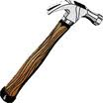
True success is measured by succession.
# 0012012
NAD Ministries Project
Notes:
“True success is measured by succession.” A legacy that does not include people has no eternal value. That is why leadership is critical. Make it your aim to practice transformational leadership, where people’s lives are changed from the inside out. That kind of leadership is based on character, conviction and Christlikeness. In other words, transformational leadership follows the pattern laid down in scripture. (CLICK)

Slide 9
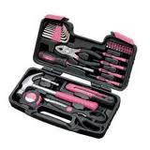
Your Toolbox
# 0012012
NAD Ministries Project
Notes:
Now, let’s take a look at what will help you build a better Women’s Ministries. If you are going to build anything, you need tools. So, let’s take a look at the toolbox for Women’s Ministries and examine some of the tools that will help you build a BETTER Women’s Ministries.

Slide 10

Vision
# 0012012
NAD Ministries Project
Notes:
As someone once said, “ If you don’t know where you’re going, any direction will get you there. The first tool you need out of your toolbox, is your pencil. (CLICK) It is the tool that draws a tangible VISION of the project. People will align their hearts with a well-cast vision. Knowing WHAT you want to build is crucial if you are to have ANY kind of success. The thing that gives you vision is a passion. The basic secret of a dynamic, vibrant, inspiring Women’s Ministries department is passion. That passion can come from only one place. Inside of YOU.
Passion for Women’s Ministries came to me very unexpectedly. As I said earlier, I’m a 5th generation Adventist. Now, there are advantages and disadvantages to this. One of the disadvantages is that it is all you know. And when you know something all your life, you often take it for granted. In 1989, I attended a national meeting of the Association of Adventist Women organization. It was the first meeting of any kind for women that I had ever attended. It was before there was a recognized Department of Women’s Ministries in the General Conference. At that meeting, the Sabbath School lesson was taught by a female pastor. That particular Sabbath, the lesson was on Heaven –and as I listened – this pastor painted a word picture of Heaven that was so vivid and compelling and inviting, that I remember saying to myself – “I can’t miss this”. Up until that time, I knew all the Bible Stories, I knew all the memory verses each quarter and could recite them on 13th Sabbath, I knew all about the life of Christ, I knew about God. But THAT DAY, in THAT SEMINAR, I wanted a relationship with Him. THAT DAY, I began a personal relationship with God for the first time in my hmhmsomething years.
At THAT moment, my passion for Women’s Ministries exploded into being. I wanted every women on the planet to have that same experience at a meeting -- where they were away from the hustle and bustle and the “muchness and manyness” of their lives. In a place there was nothing to distract them from the opportunity to hear the Voice calling to them to become His beloved.

Slide 11
Notes:
Passion – whatever you do without it may be technically correct, but it will lack that “something” that draws women to that hunger for God. With passion comes commitment. Commitment is the key that unlocks the door of success. Without that key, the door will never open. No amount of genius, talent, finesse or “right connections” will ever bring the fruit of success without a real commitment. Every great endeavor has a price tag. The greater the job, the higher the price. That price tag is known as commitment.

Slide 12

Blueprint
# 0012012
NAD Ministries Project
Notes:
Your second tool is a blueprint. (CLICK) It’s pretty hard to build something, if there isn’t some sort of a plan. That plan has to be comprehensive and detailed. If it isn’t, you will be overwhelmed, over-reaching and over-budget. In terms of both the Department and events MY “blueprints” are my spreadsheets. For purposes of demonstration – I will share a little with you about my retreat spreadsheet.

Slide 13



# 0012012
NAD Ministries Project
1/18/2011
Notes:
(CLICK) Much to my dismay, it didn’t just magically materialize on my computer screen one day, it evolved over a couple of years and is still evolving. Every year, I tweak it and adjust it and narrow it’s focus a little more.

Slide 14
Spreadsheet Tabs
Wknd 1
Wknd 1
Wknd 1
Wknd 1
Phone Nos.
Budget
Staff
Do
Get
Take
Schedule
Programming Wk. 1
Programming Wk. 2
Programming Wk. 3
Programming Wk. 4
Teen Track
Y A W‘s
Track
Housing
Scholarships
# 0012012
NAD Ministries Project
1/18/2011
Notes:
(CLICK) The tabs of the worksheets indicate the contents of any specific worksheet and each one has every detail of that particular subject. I make every effort to have all the information that is necessary to accomplish the event called “Retreat” in one place so that I don’t have multiple notepads and sticky notes and files to sort through every time I need to find something.

Slide 15
NAD Ministries Project
Notes:
(CLICK) The budget worksheet has every item that I need to track as well as a line that indicates the current year’s budget allotment for that line item as well as a column for the actual expenditures. Specific details are inserted as comments into a particular cell. Totals are automatically tabulated using formulas and at the end of retreats, it doesn’t take too long to figure up costs and income. Another column automatically calculates the difference between the actual expense total and the budget, so I am able to see at a glance where I stand.
On the Conference Budget – Women’s Ministries is a single line item – but I need to keep track of specific costs, so I worked with the Undertreasurer to have account numbers assigned to the areas I wanted to track. I use a similar spreadsheet for the Department to track all the income, expenditures, status of restricted accounts, and miscellaneous expenses. My department account has approximately forty accounts, each of them with formulas that automatically total additions to the account (CLICK)

Slide 16
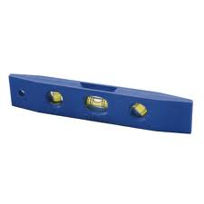
Level
Leveling out your leadership
# 0012012
NAD Ministries Project
Notes:
Leveling out your leadership. Keeping a balance. There are sooooooo many things that have to be done and sometimes it’s hard to keep all the balls in the air, but if you do not have balance – you can’t be successful.
You have to have – first and foremost – a passionate “up close and personal” devotional life. Then you need to make sure that your family isn’t neglected. And your team needs a lot of TLC – which we will address a little later. In this mix, also, comes taking care of you.
Have you ever been on an airplane and heard the flight attendant say, “ In the event of loss of cabin pressure, the oxygen masks will drop down from the overhead panel. Place the mask on whoever you are caring for and make sure that the oxygen is flowing into their mask, then find one for yourself?” No ? Me neither. What she says is “Place the mask over your mouth and nose and breathe normally.” Why does she say this ? It’s because if you are dead, you can’t take care of anybody.
The same principle applies to your leadership. If you are exhausted, you can’t focus as well, can’t plan as well, aren’t as nice to people as you usually are, aren’t as flexible and adaptable as you should be, aren’t able to maintain a positive attitude as well.
To be balanced, you have to keep your purpose in mind. When you focus on your purpose, you are able to see the difference you can make. Your work can then become exciting and fulfilling. Without purpose and connection, work becomes drudgery. (CLICK)

Slide 17
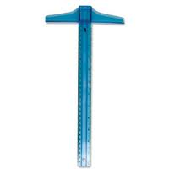
Square
Don’t Be Square – Communicate !!!!
# 0012012
NAD Ministries Project
Notes:
Don’t Be Square – Communicate !!!! Whether it is your boss, your kids, your co-workers, your administration, your constituents or your team, if you don’t communicate – you will be dead in the water.
Communicate face to face, by telephone calls, by email, by text, by voice mail, by snail mail, by any means possible. Stay connected by communicating.
EVERYTHING requires communication. Share your passion, share information, share education, share ideas, share inspiration, share burdens, share joys, appreciation, share yourself. (CLICK)

Slide 18
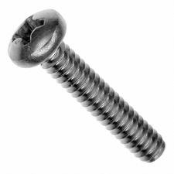

Nuts and Bolts of
Events
# 0012012
NAD Ministries Project
Notes:
Event planning is the hardest the first time you do it and get’s easier every time. I’m not going to go into a lot of detail on this subject, because, there are so many resources that will help you as you begin to plan an event. Go to the web and “Google” Event Planning, Call GROUP, The NAD and GC websites have wonderful resources for you. There are thousands of places that you can find help.
Just a few things to remember:
The First thing you must do is invite God to direct you as you begin to make decisions.
Second - pray for the ladies that He knows will be attending.
The Third thing, is to determine what your event will be, and choose a theme or focus for it.
Fourth – Pray for the speakers who may be coming
Fifth - you need to decide how much you have to spend or how much it will cost to do what you want to do.
Sixth – Pray for your teamm
Seventh - you have to plan what will happen at your event and who will be involved as guests, speakers and helpers.
Eighth – Pray for yourself

Slide 19
Notes:
Ninth - if there will be food involved, decide what the menu will be, who will prepare it and how it will be served. Additionally, you need to plan who will clean up and put the venue back in order.
Tenth – Pray for the Event
Eleventh – build a Spreadsheet that contains every detail that you will need to see to and use it.
Twelfth - Pray – about EVERYTHING

Slide 20
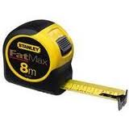
Tape Measure
Do you measure up ?
# 0012012
NAD Ministries Project
Notes:
(CLICK) Do you measure up as a leader ? Remember the quote at the beginning ? “True leadership is measured by succession.”
What is the measure of your success?
Part of your job, involves mentoring, delegating and training new leaders – perhaps and hopefully, your successor.
One way to be sure that you measure up is to keep improving. Read everything you can find about leadership - John Maxwell is a veritable treasure trove of information that will ensure that you measure up in the Leadership department. Especially his “Maxwell Leadership Bible”. If you can only afford one resource on leadership, get that one. It is literally packed FULL of information, inspiration and motivation.
Chuck Swindoll has some wonderful stuff too. One in particular, “Hand Me Another Brick” – will revolutionalize your leadership. Another of his that is a favorite of mine is “Improving Your Serve”.
A man who writes the most amazing things about the heart of a servant is Dr. Dale Henry. His book, “The Proverbial Cracker Jack”. He tells you how to get out of the box and become the prize. He says “Wake up!” Experience a new passion to be the best you can be. To become the prize, you need a vision. To get that vision, read his book. He has a WICKED sense of humor and you will be on floor laughing as he shares some of the experiences that shaped his philosophy. Through dozens of stories both inspiring and hilarious, Dale shows the wisdom of a philosophy of service and self-giving.

Slide 21
Notes:
My personal favorite – far and above ALL the rest - is one I have read more than once and given away to a number of people. It is by Dr. Kevin Leaman and William Pentak and it is titled: The Way Of the Shepherd”. It is a contemporary parable about your heart, your character and your priorities. It’s countercultural, flying in the face of modern values. It is out of the box – which resonates with me as I have been out of the box since I was – oh – two !!!!!

Slide 22
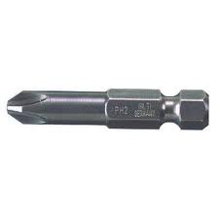
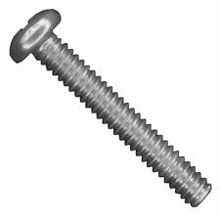
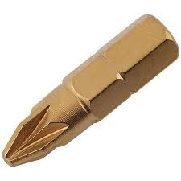
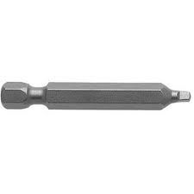
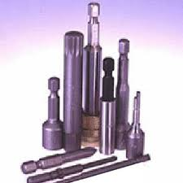
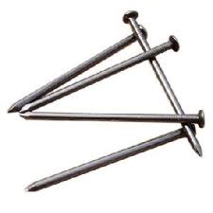
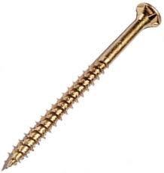
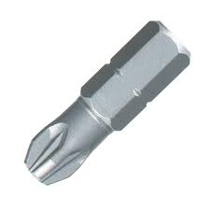
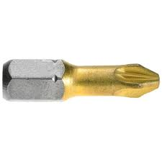

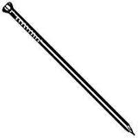
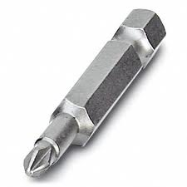
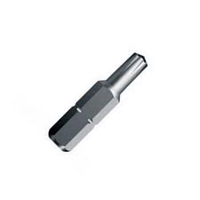
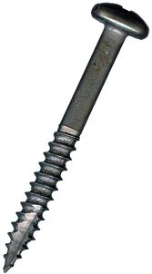
Fasteners
# 0012012
NAD Ministries Project
Notes:
What do you see here that catches your attention ? They are all different – Nails, machine screws, brads, screwdriver bits of different sizes and shapes, wood screws. And they are all alike! ? Well, yes, in a way they ARE all alike. They are ALL fasteners of some sort. This is a picture of my team, and yours. If you don’t have a team, you are doomed to fail. It isn’t any kind of wisdom or even feasible to imagine that you can do Women’s Ministries at the local level, much less the Conference or Union levels without a team.
A disclaimer here: I’m going to be very frank about the process of choosing Committee members. What I’m sharing comes out of 12 years of experience and dealing with – from 15-24 women in any given year.
One note that may help you, if you don’t have a team. As you begin to develop one, do everything in your power to make it possible for you to choose your own team members. I know that in some local churches, nominating committees choose the team members – but if you can, make every attempt to find a way to be allowed to choose your own. Now, the word choose is subjective. I have found, that I really don’t have to go looking for them. Almost always, God finds them, brings them to me and dumps them in my lap. It’s the most astonishing thing to me.
There are two reasons for choosing your own team. The first is that they need to be women that you are comfortable with and at least one, to start with, should be a good friend (that is so that especially if your church hasn’t been active in Women’s Ministries for a while or you are brand new to your office with no experience. It’s good to start out with someone who “has your back”. Besides that, you may need to “call in a marker” as you begin and it’s always great to have a friend that you can call on for that purpose.)

Slide 23
Notes:
There will be plenty of opportunity for you to “build your character” dealing with a Committee member who doesn’t quite “fit”. A word of caution. You don’t always want just anyone who volunteers. There are here and there, women who will volunteer for anything and everything – that is not to say that they don’t want to serve – they just don’t realize the level of commitment it requires to participate in a vibrant active Women’s Ministries program. So they are part of 6 or 8 different ministries and wisdom tells you that it isn’t possible to do that many things with excellence – generally.
Another thing that could impede your forward progress, is to have a “one-man show” or a couple of “divas” on your committee. Your committee members need to be willing to be team players. At least in my case, we have too much work to do, to be able to deal with that particular challenge.
When someone comes to my attention as a possible Conference Women’s Ministries Executive Committee member, I will usually chat with her on general terms to see what her attitude is towards Women’s Ministries. If she seems enthusiastic, has attended WM events at her church and has attended Retreats, I will often call her Pastor and see how she participates in the church program. Is she involved, does she participate in many of the activities and programs there? Does she hold an office? Is she usually prompt, dependable, return tithe, compatible with others? ( At the local level, this may not be possible – a Pastor may not share all of this information with you – nor should he. If you know her, you may know most of this information already. )

Slide 24
Notes:
The second reason to choose your own Committee members, is that you need a cross section of your congregation or constituency to serve with you. I tell my local directors that they should try to find the following people in their congregations for their committees. A young single adult woman, a college student, a widow, a young mother, a couple of professional woman, ideally one in their 30’s and one in their 50’s or 60’s, an older grandmother type or two, a single mother, a teen. The reason for this is that when you hold some sort of WM event – be it nurture, outreach, educational or some other activity – each of these team members will draw people from their circle of friends to attend. This will help your attendance. Additionally, they will have their fingers on the pulse of the needs of that particular demographic. The Level One Leadership Certification curriculum has a module about Assessing the Needs of the Local Church. There are some sample of surveys in it and I strongly encourage you to access it and use it to find out what types of things your ladies want to participate in or will meet their needs. It makes no sense to spend hours of time, energy and money to plan something that no one wants to attend. None of us have that much spare time and money to waste. These team members from every segment of your congregation will know or can find out the things that appeal to the largest number of women that you serve.

Slide 25
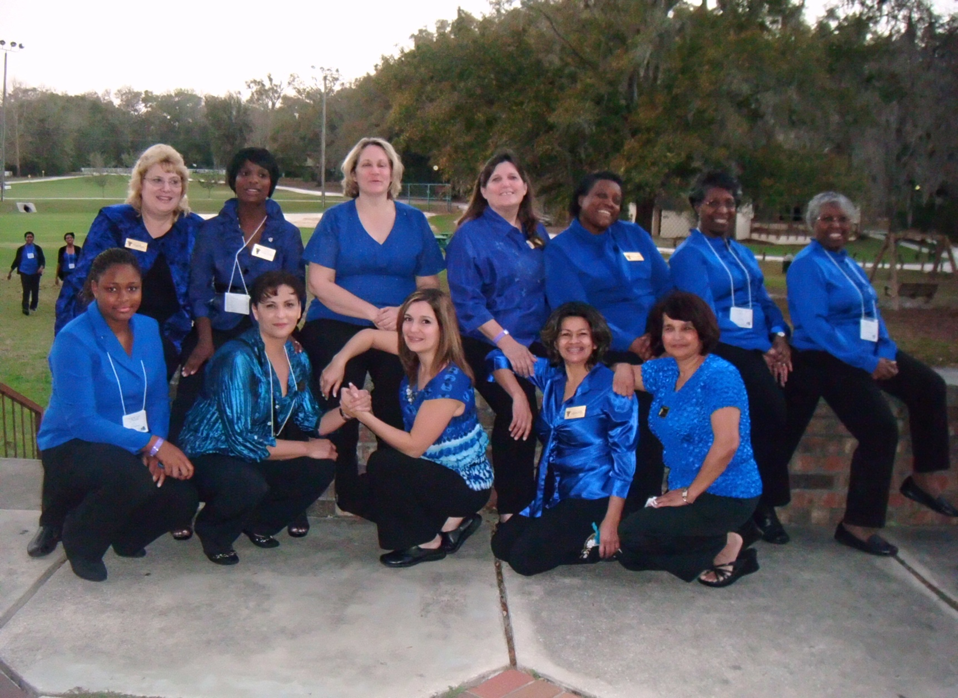
Team Extraordinaire’
# 0012012
NAD Ministries Project
Notes:
I am not one to brag, generally, but I will tell you unequivocally that I have the most amazing team in the division – well, on the planet actually. We call ourselves “The Martha Girls of the Vineyard”. We are all Marthas by nature, but knowing that, we realize how important it is for us to be in the Vineyard, so we can stay connected to the Vine. The first book that we used for Committee was “Having a Mary Heart in a Martha World”.
My team is a group of:
Women, all different in shape, color, size, life experience, education, profession, marital status, number of siblings, country of origin, number of children and types of personality, that are as varied as their fingerprints.
Women who have a passion for nurturing their sisters.
Women who sacrifice time, energy and often their own funds to participate in the ministry they love. (There was a time, when we had severe budget issues at the office, that they divided themselves up into teams and brought lunch for everyone for Committee meetings.)
Women who empty out their homes (and sometimes – the houses of their friends) at Retreat time to provide things that we can decorate with to save us money. In addition to that generosity, the majority of them take vacation time from work for four weekends in February to minister to their sisters who attend the retreats.
Women whom I love as if they were my own children.

Slide 26
Notes:
Women who call me “Mom”, (even the ones who are somewhat OLDER than me – though there aren’t very many of THEM !!!!!)
The women on my team are the fasteners that keep Florida’s Women’s Ministries together. They are the light of my life, my “girls” and for the past several years as my husband descended into dementia and then spent 4 years and 8 months in a locked unit in a nursing home, they were my sanity, they kept me and the ministry going.
My girls know beyond the shadow of a doubt that they are mine, that I love them, that anyone who has a problem with them, will have a problem with me, that I have their back no matter what and that they can call me anytime, day or night.
I KNOW them. I know their kids, their spouses or significant others and what they do for a living, I know their favorite colors and foods, I know what they hate, I know what they do at work and a lot of the foibles of their co-workers, I know what they collect and what they can’t stand. I know their personality types and the relatives they aren’t so fond of. I KNOW them.
Each of them is wounded or broken in some way, as am I. Some have expressed to me that they don’t feel as if they are good enough (because of being wounded or broken) to serve on the Committee, and I am so gratified to be able to tell them that the entire committee is composed of wounded healers and that those are the best kind. Wounded healers understand what it means and how it feels to be wounded. And that understanding makes them more alert to wounds in others. They have a “sixth sense”, that picks up on the signs and red flags that indicate woundedness in others and can reach out to them in love.

Slide 27
Notes:
I’ve never lost a team member because she got sick of being Cared for. Not one of them ever said to me, “Mom, I think it’s time for me to move on because you just love me too much, and I don’t like it.”
“Committee Care should be very near the top of your list of To-Do’s. It will pay off in dividends you will hardly be able to believe.

Slide 28

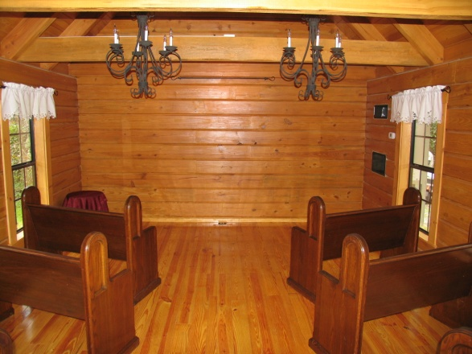
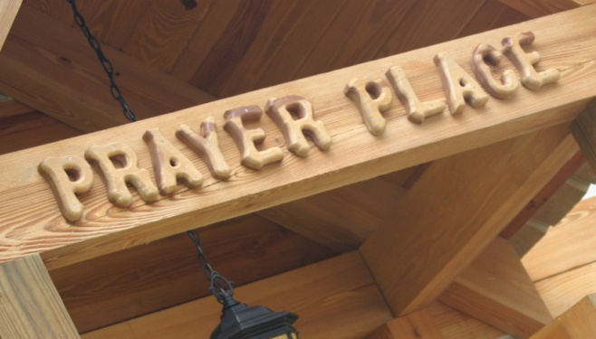
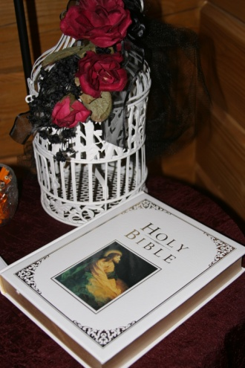
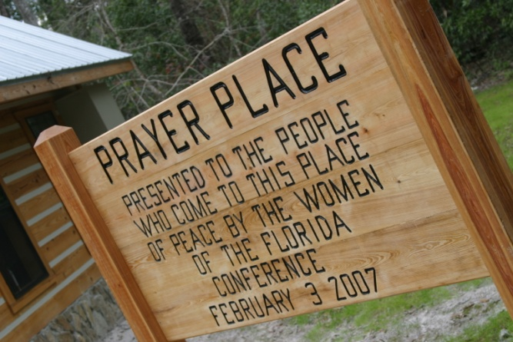
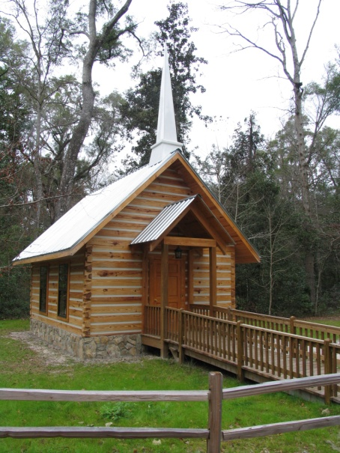
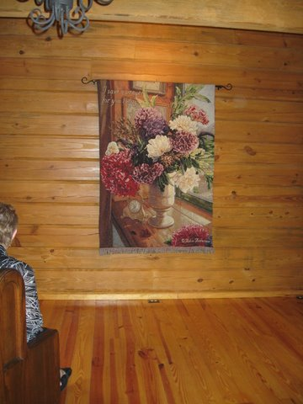
A little peek at my pride and joy:
Florida’s Women’s Ministries
NAD Ministries Project
Notes:
I’m going to take a moment to share a few pictures of my team at various retreats and meetings – becuz’ like all proud Mamas, I love to brag about my “kids”, though some of them would better qualify as “grandkids” !!!!!
This first slide is something we are ALL very proud of. Women’s Ministries spent 5 years, gathering together a dollar and sometimes five dollars at a time over 5 years – 25,000 dollars to build “The Prayer Place” at Camp Kulaqua. It is a gift from the women of the Florida Conference to those who come to Camp. It is heated and air-conditioned and open 24 hours a day – 7 days a week. The sign in front reads “ Presented to the people who come to this place of peace by the women of the Florida Conference.”

Slide 29
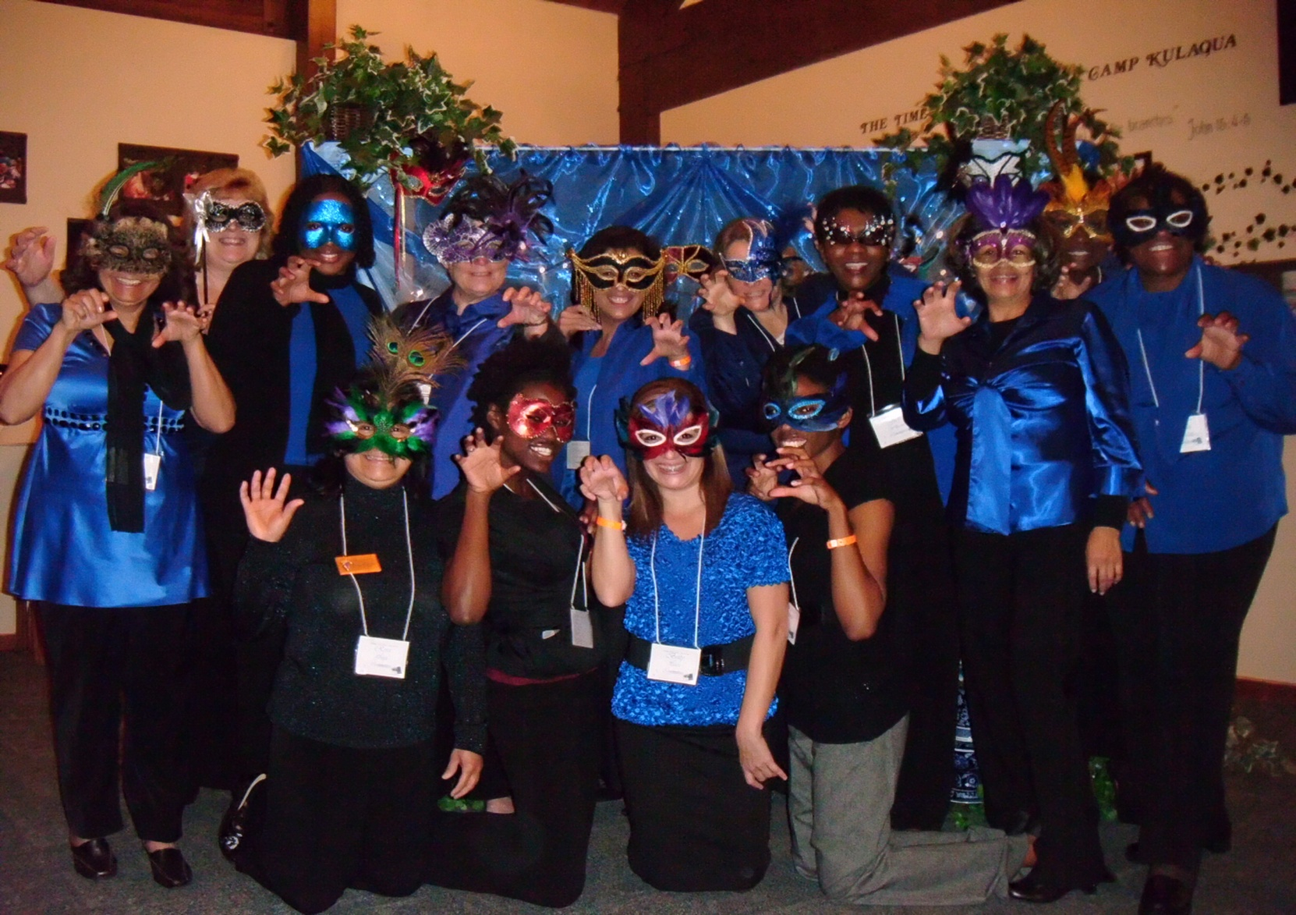
Team Extraordinaire’
# 0012012
NAD Ministries Project
Notes:
On occasion someone will say to me, “ I don’t know how you do everything that you do. How do you put on such a large retreat?” I say – “I don’t – my team takes care of that. That’s their job. They take care of retreats, and I take care of them.” I spend a lot of time taking care of them. I usually talk to some of them every week and sometimes more than once a week.
Because we have such large retreats, and there is so much work to do, to keep it all running smoothly, they really don’t get to participate in the retreats. So to make up for that loss in a small way, I provide them with a DVD that has all the sermons on it after retreat. I usually present that to them at the “Hello-Goodbye” meeting.

Slide 30
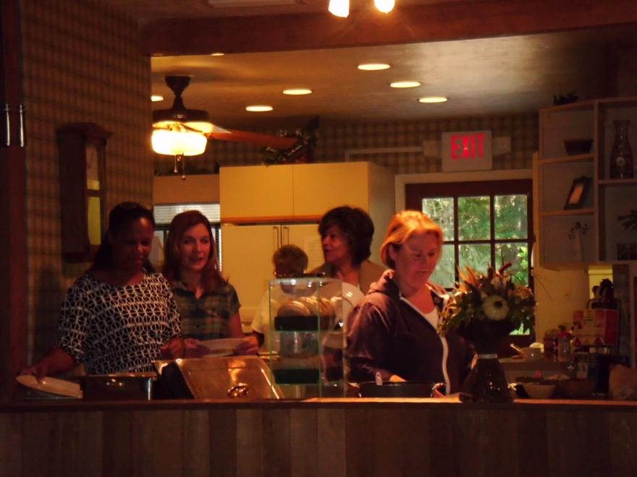
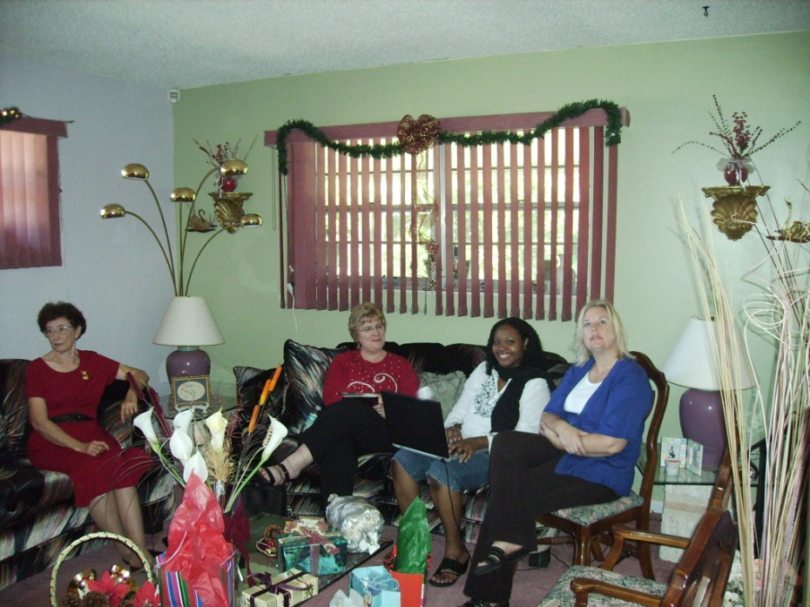
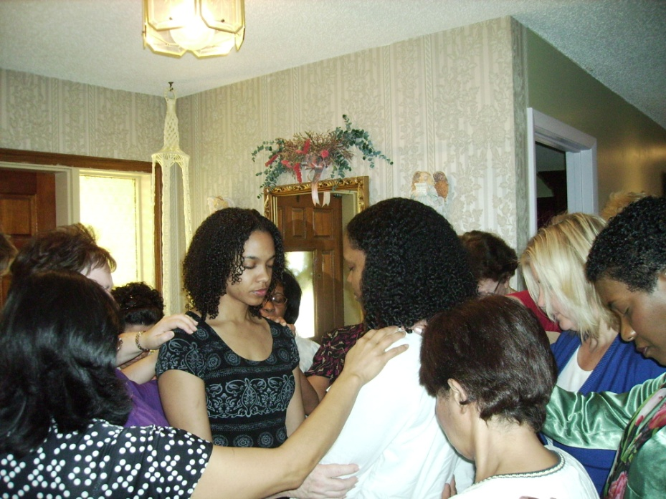
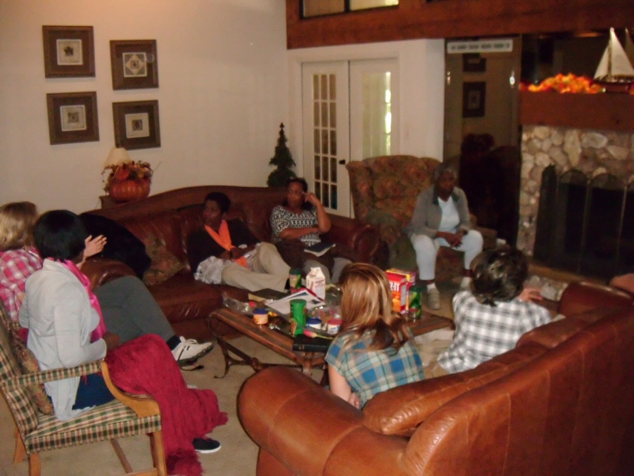
# 0012012
NAD Ministries Project
Notes:
We are a very large conference. We have nearly 300 Churches, Companies and Mission Groups. Of that number, probably less than 30 do not have Women’s Ministries Directors.
Retreats are only part of what my Department does. We conduct “Hope for Hurting Hearts” in English and Spanish, annually. This is a small, healing - educational retreat for women who were sexually abused as children or are victims of domestic violence.
We are currently involved in the Leadership Certification Project. We are traveling to each of the 7 areas of the Conference each year to present one level of WM Certification to the Director’s in that area. Last year we covered level 1 and this year level 2, and so on. The girls on my team are heavily involved with this and travel with me or come to the areas on their own to present modules on the weekends.
We are attempting to work with the local Directors in each of the areas to hold an Area Meeting in each of the Conference Areas each year.
That is in addition to keeping up with a very large database, maintaining our Webpage, various and sundry meetings at the office and Union level. Sort of the things that ALL of you do, it’s just that our numbers complicate the logistics of many of the things we do.

Slide 31
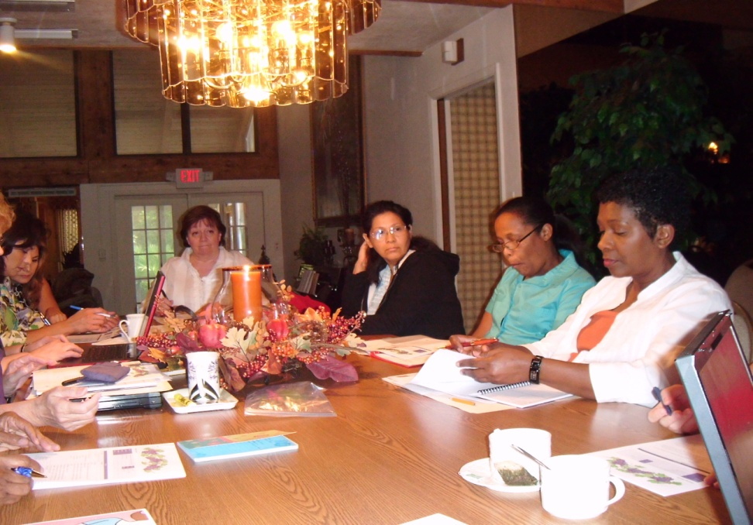
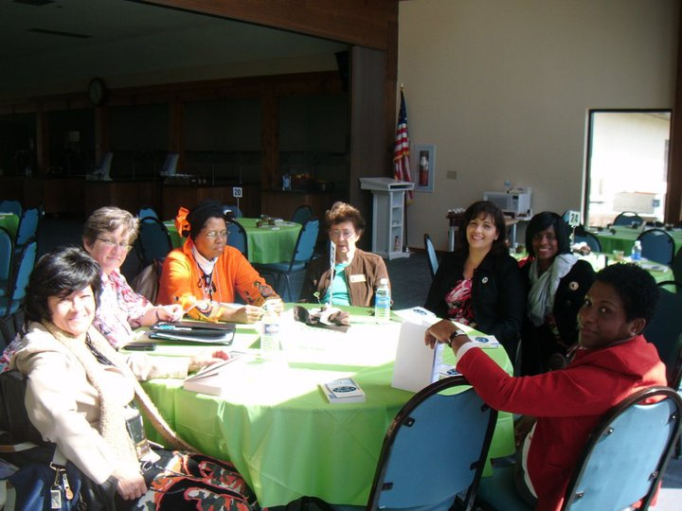
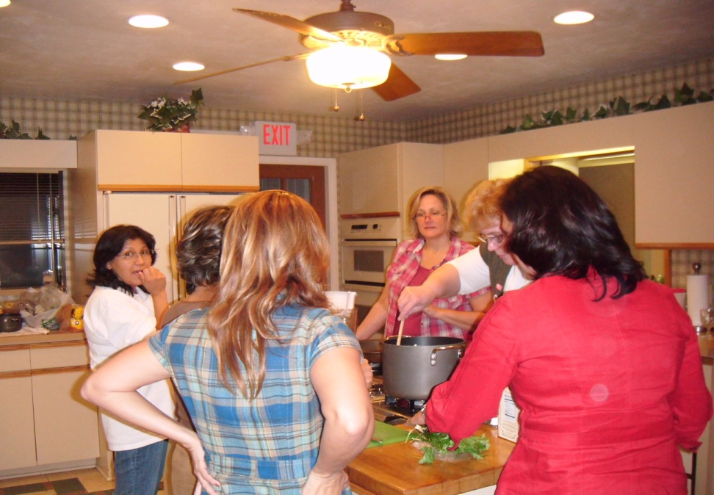
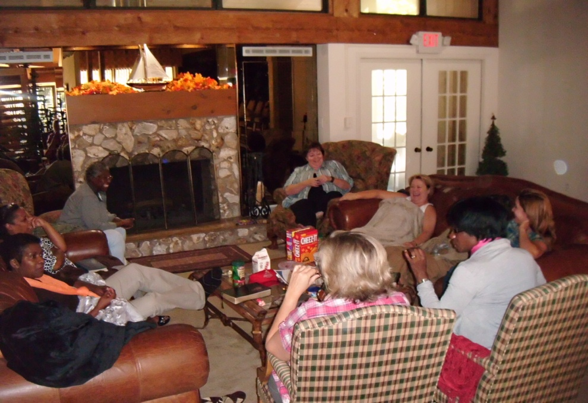
# 0012012
NAD Ministries Project
Notes:
A few years ago, to make up for the loss of the nurture of retreats for my girls, I began to hold what I call Fall Escape. It is a retreat for the Committee, held at the camp, in the fall when the weather is cooler. It is a weekend of rest, laughter, relaxation, fun good food, team building, laughter, devotional emphasis, good food and fun. A time when they get to be the recipients of the “pampering” that they so generously give to the ladies who attend the retreats.
There is a sisterhood among my girls that is the most precious I’ve ever experienced since I was in academy. In the spring after they take the month of March off to catch their breaths, I hold the first meeting of the new Committee year – which runs from March through February, at a local restaurant. It is called the “Hello-Goodbye” meeting as we greet new Committee members and say farewell to those whose terms are up and are leaving us. At that meeting, I give them a “bunch of grapes”. They are different every year – but the little collection they are adding to annually, reminds them that they are “The Martha Girls”.
Throughout the year, I keep my eyes open for little inexpensive gifts that I gather up to present to them at Hello-Goodbye, Fall Escape, and the Christmas meeting as well as when they arrive at the retreats.
There isn’t anyone who doesn’t appreciate affirmation. So pass the praise. Look for opportunities to publicly encourage and affirm your team’s efforts. You can’t afford to pay them what they’re worth, and most of them wouldn’t take the money, but a well-timed word of praise is priceless.

Slide 32
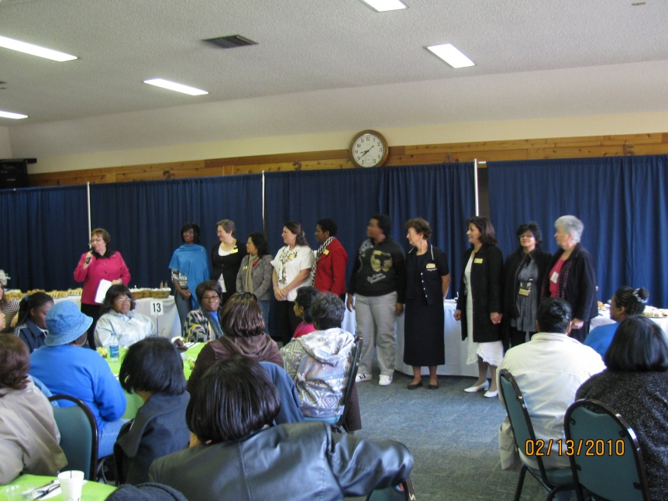
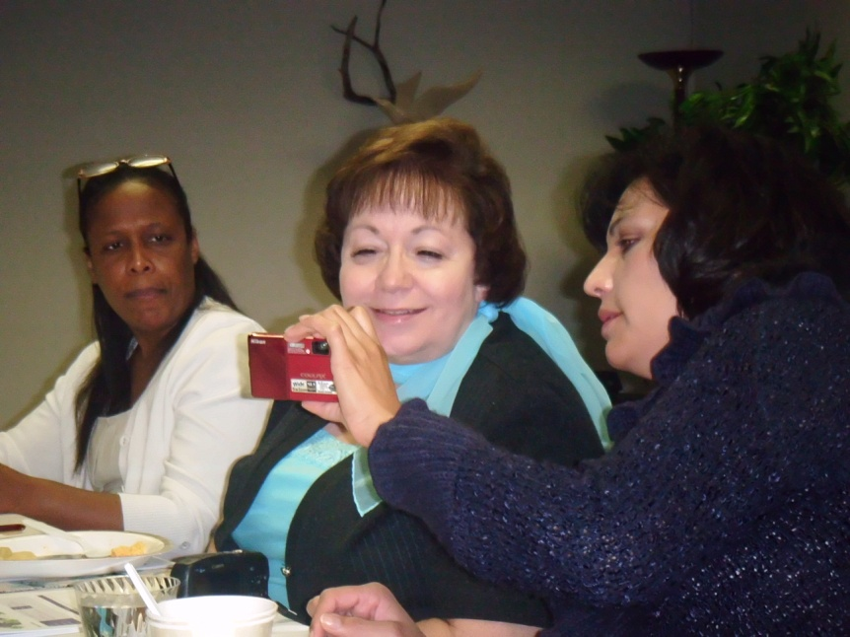
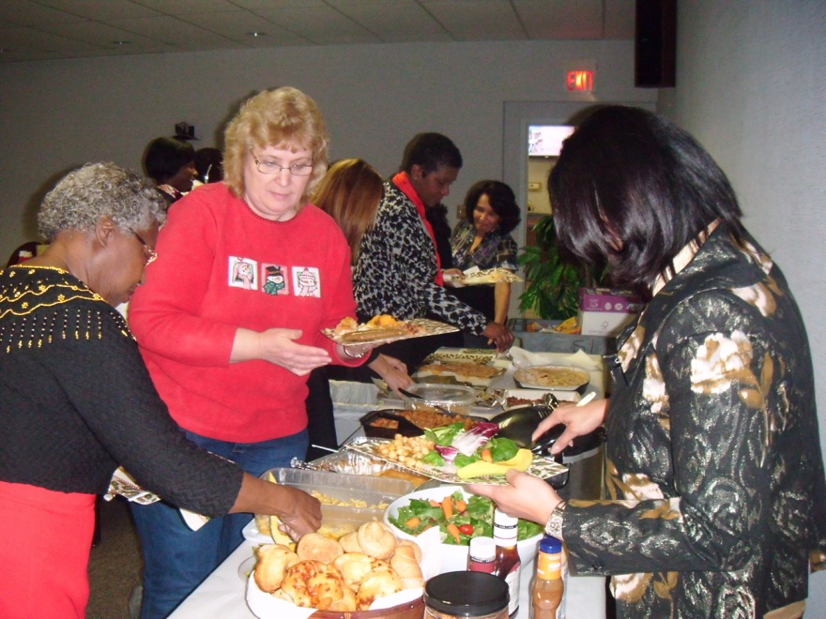
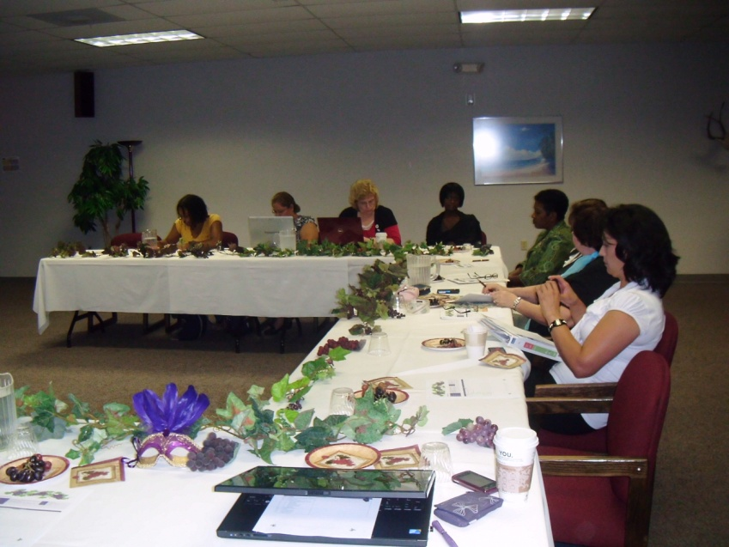
# 0012012
NAD Ministries Project
Notes:
As our Committee grew, it became unwieldy to field 15 or 20 different opinions on every subject that came up for discussion. So in an effort to take some of the bulk out of the regular Committee Meetings, so that we didn’t have to spend 7 or 8 hours at each meeting dealing with the more mundane details that have to be dealt with, I developed what I initially called the “Inner Council”, and later, the Ad-team. Each year both the Ad-team on their weekends, and the full committee in the fall and winter, have a book that we read one chapter out of once a month and then discuss at the Meeting.
The Ad-team is a group of 5 of my girls who come to my home once a month year around to spend the weekend and work on Women’s Ministries. They bring their sleeping bags or aero-beds and arrive on Friday evening in time for dinner and leave around noon on Sunday during the summer. We work on ideas for Speakers and presenters, we work on the ideas for the Menu for the Retreats, the poems for the “’Burma Shave” signs, the table gifts that we will have for the ladies, what to do for entertainment, discuss things that need to be updated or let go, and tend to the myriad of details that go with conducting a retreat. We work on the next year’s calendar, the next year’s Retreat theme, we entertain new ideas for ways to reach out to the women in our conference. We work on the logistics for the Leadership Certification Project.
Then, in the fall and winter, from September through January, we have the entire Committee meet on Sundays once a month. At those meetings with the everyone in attendance, we present them with things that we need them to decide on. We present them with a couple of choices to determine the final “Burma Shave” poems, the table gifts that we will end up with, the final menu for the Retreat weekends, some decisions about decorations, and the theme for the following year – as we work on two years at a time.

Slide 33
Notes:
There is a sense of ownership of the Ministry in my girls. It is THEIR Women’s Ministries. I believe that the secret of an amazing team is that ownership. There are times when they will ask me, “What do you want here, or to do about this ?“ I often tell them – “This is your decision – you need to decide what we will do.” On rare occasions, I’ll pull rank and say, “ I feel strongly about . . . “ “I’d really like us to . . . “ But that probably doesn’t happen more than once in any year.
Your team will function so much better if you give them ownership, than if you dictate and assign. I rarely give out assignments. I usually ask them to volunteer for the tasks that are to be done. Sometimes if no one volunteers, I’ll ask one of them if they would please be responsible for, or do such and such, especially if I know she is gifted in that area or if I see potential in her in that area.

Slide 34
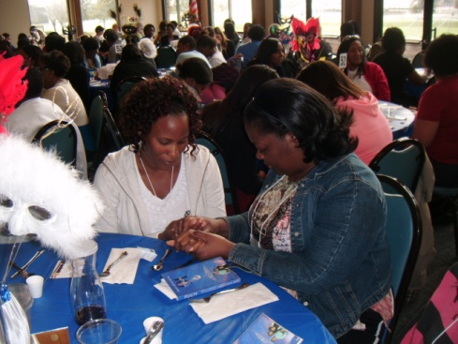
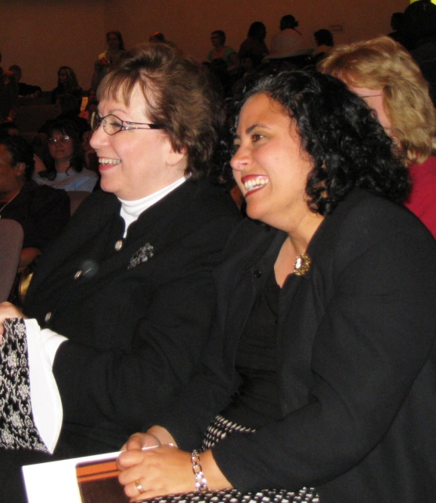
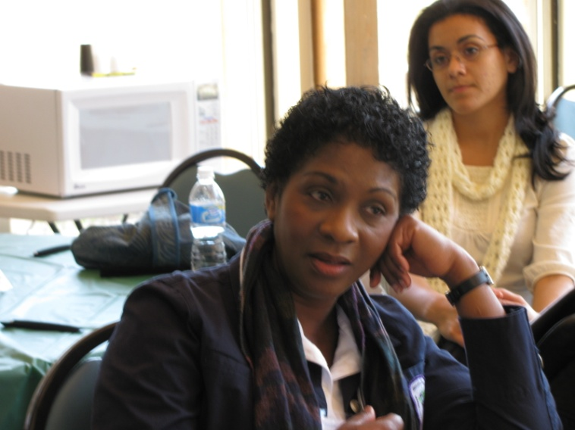
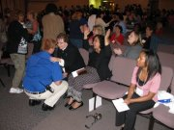
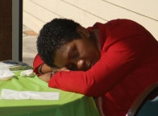
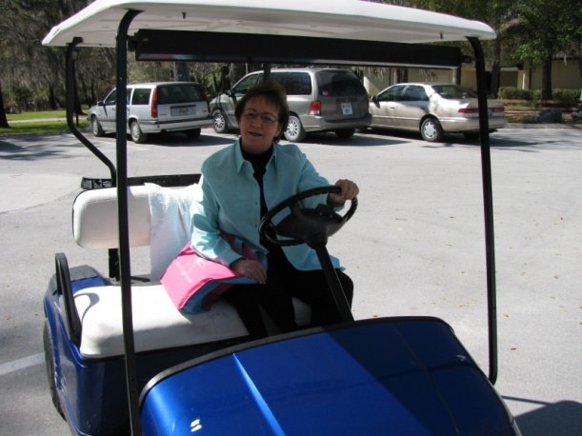
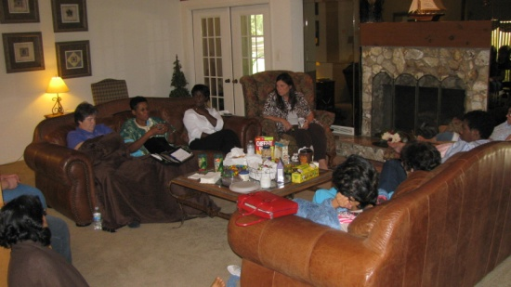
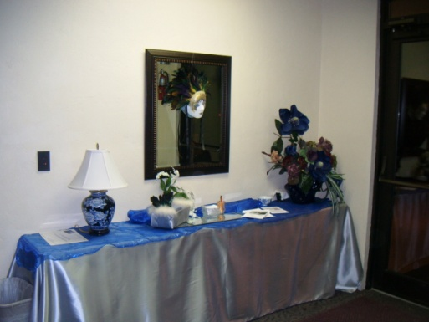
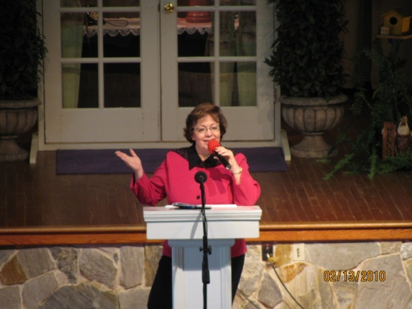
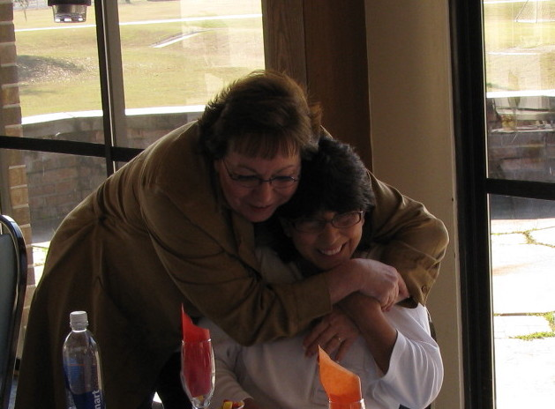
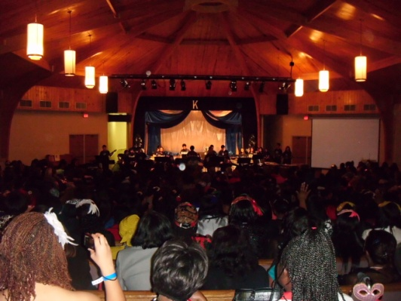

# 0012012
NAD Ministries Project

Slide 35

Your Toolbox
# 0012012
NAD Ministries Project
Notes:
So, (CLICK) in the end, you have a tool box – maybe not the same one as your husband or boyfriend or son has in the garage – but a tool box all the same.

Slide 36






Your Tools
# 0012012
NAD Ministries Project
Notes:
So, (CLICK) you have your tools:
A Hard Hat – notice I didn’t say a HARD HEAD. A hard hat protects your head. This is to remind you that you need to protect yourself. Meaning – you need to develop a thick skin. Don’t be easily offended. Don’t grow; as an old pastor friend of mine use to preach a sermon about – “Long Toes”. Don’t hold grudges or hang onto hurts. Remember that you never know the back story.
Gloves – though you can’t see it from here, they are made of kid. Use them with everyone with whom you come into contact. Handle hearts AND people with kid gloves.
Your trusty Tape Measure – to monitor whether you are measuring up to your Leadership potential.
Your Fasteners – Your most IMPORTANT tool after prayer. Each one, different from all the others, but each one beautiful in their own unique way, each one vital to your team - and you are the tool that holds each one of them. And God’s is the hand that holds you.
You are the one who cares for them, keeps them polished and shiny, keeps them in pristine condition to do their particular job. You are responsible for their well-being as a fastener. You are the one who they depend on to see the vision and to share it with them, which in turn inspires them to greater service.

Slide 37

# 0012012
NAD Ministries Project
Notes:
As a leader, (CLICK) you have a veritable bouquet of tools – they are not only useful but beautiful and like all growing things, they make more of themselves. They are for you to share – giving them to your team without reservation, teaching them how to use them, watching them as they find new uses for them, encouraging them to use them regularly and to search for new tools.

Slide 38

# 0012012
NAD Ministries Project
Notes:
But remember this, if you don’t take another thing away from today.
No matter what tools you have.
No matter how many tools you have.
No matter if they are the most expensive tools money can buy.
No matter how expert you are at using your tools. (CLICK) No matter what – if you don’t have a team, you really don’t have anything.

Slide 39
?
?
?
?
?
?
?
?
?
?
?
?
?
?
?
?
?
?
?
# 0012012
NAD Ministries Project
Notes:
So, in case I wasn’t clear on anything, or didn’t explain it well enough, or I don’t speak your language – now I the time for you to ask me whatever you want.
Questions are the way you learn and I am happy to take all of them until Carla tells me to sit down.
Now, as we leave, I have two things to say to you.
May God bless you in your leadership and
Go home and get to work !!!!!!

