Slide 1
Pathfinder Diamond Jubilee Celebration

Slide 2
Let’s celebrate the ministry of Pathfinders and the lives this movement has touched during the past 60 years.

Slide 3
Desmond Doss
Pathfinder to Hero
Notes:
Desmond Doss

Slide 4
• “As a young boy, I decided to follow God no matter what the cost.”
• “I had no idea that this would lead me to saving the lives of others in Okinawa.”
• “I used a double bowline that I learned to tie as a boy to rescue each man.”
• “Please God, let me get one more man down was my prayer.”
• “I was honored to received the Congressional Medal of Honor, presented to me by President Harry S. Truman.”

Slide 5
Luther Warren
• “I was 14 years old and believed Jesus was coming soon!”
• “I wanted to help others learn about Jesus.”
• “My friends and I formed a youth society for Adventist youth.”

Slide 6
Flora Plummer
• “I was a director of the Sabbath School Department for the world church.”
• “I wanted to help junior and teen-aged youth become involved in service and build their relationship with Jesus.”
•”In 1908, the name Seventh-day Adventist Missionary Volunteers was adopted for all youth societies.”

Slide 7
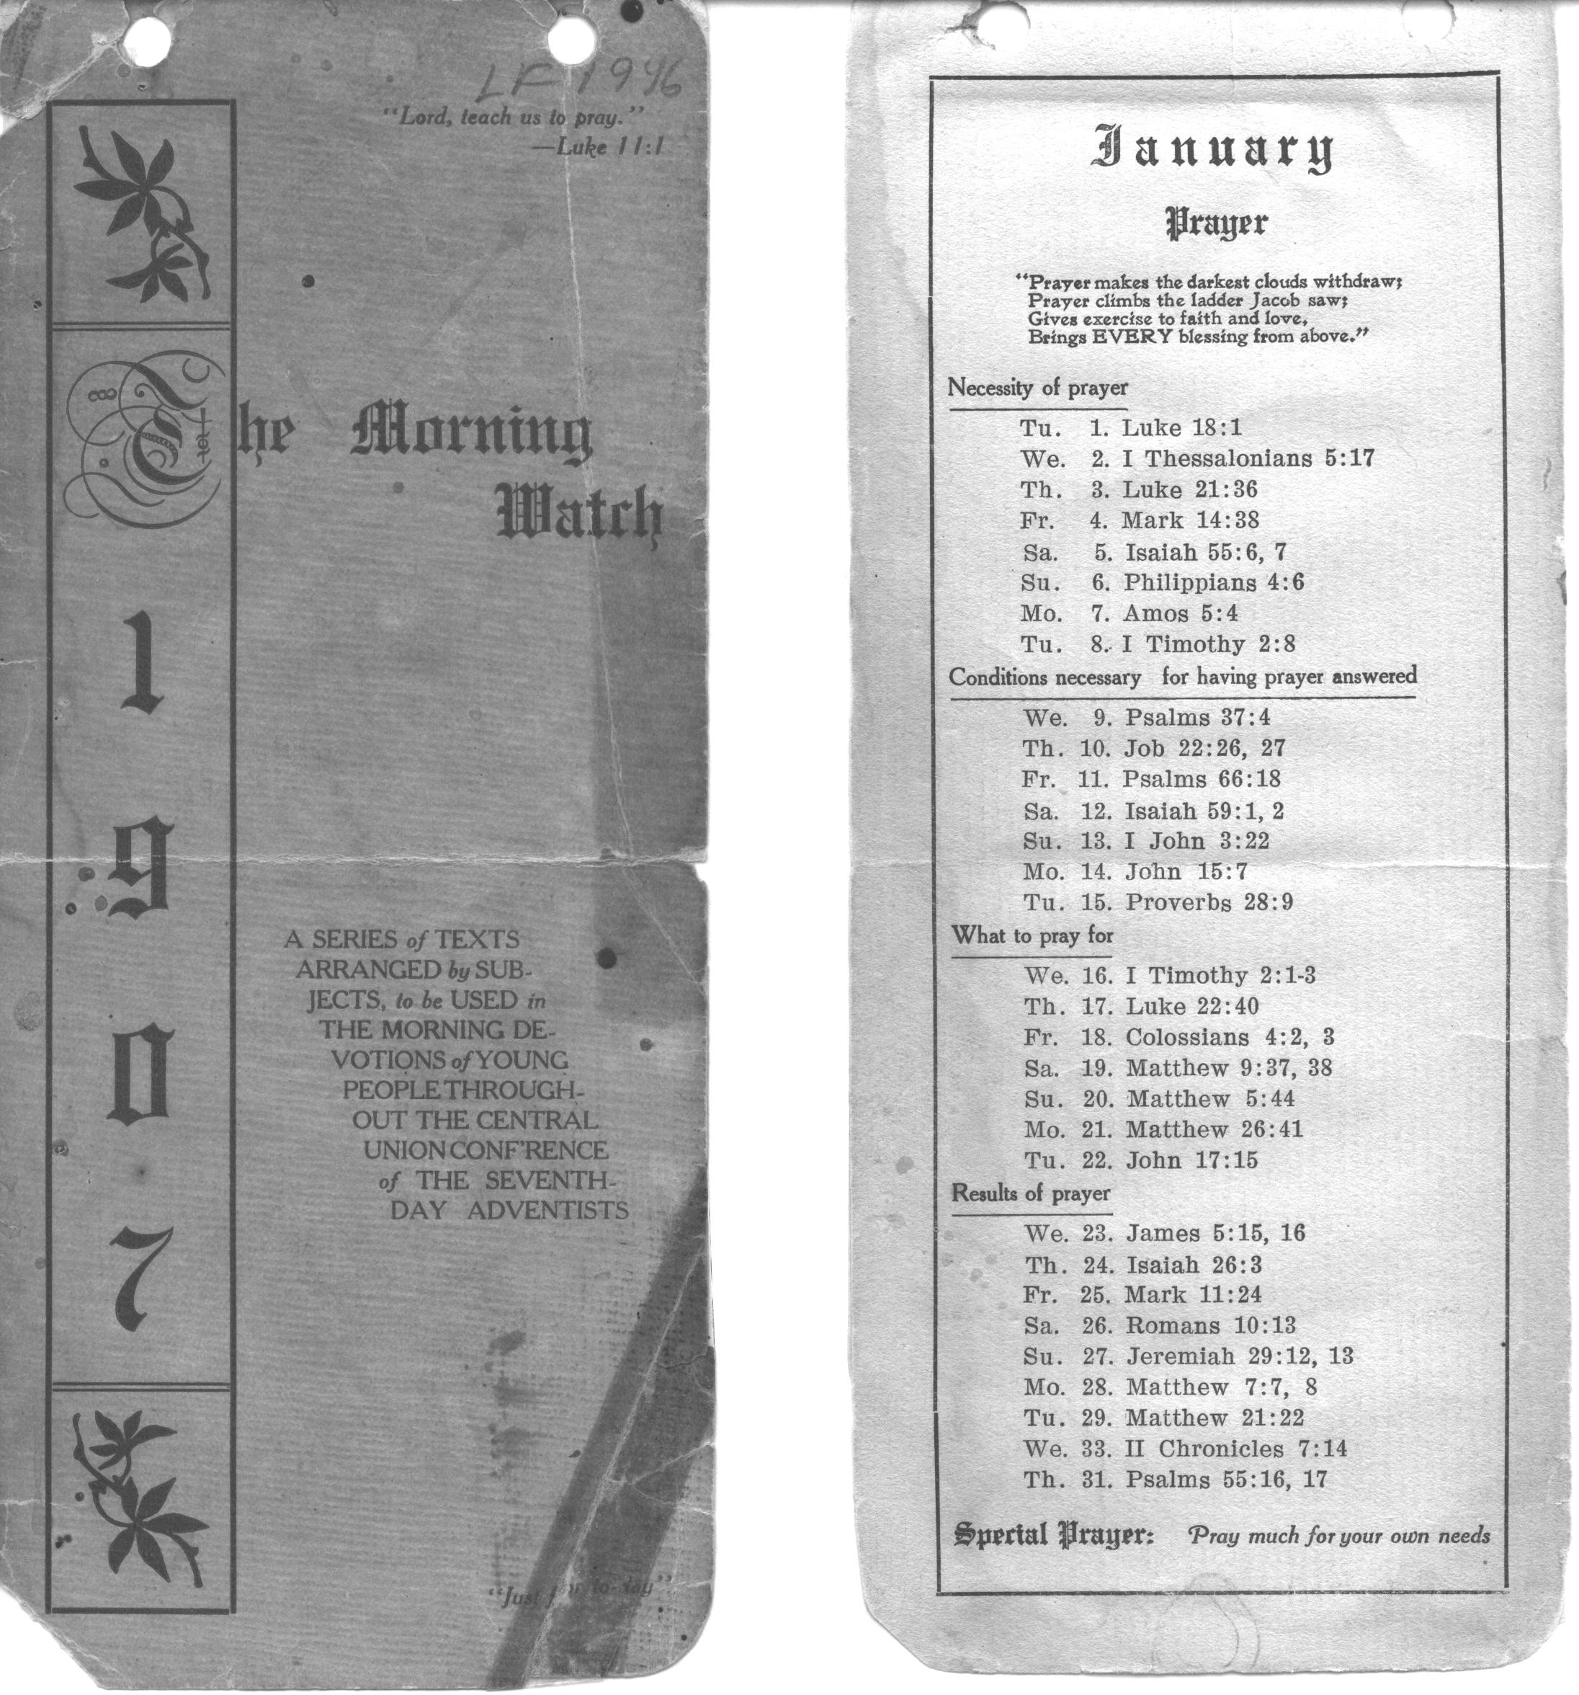
Morning Watch
Pathfinders today still keep the Morning Watch, a devotional plan that helps build a friendship with Jesus.

Slide 8
Harriet Holt
• “I made sure that both boys and girls would have many different activities in which to participate.”
• “I developed outdoor activities, handicrafts and outreach events.”
• “I helped choose the names for the training classes–
Friend, Companion, Comrade and Master Comrade.”

Slide 9
A. W. Spalding
• “I liked to take boys and girls camping. I told many stories about early Western explorers.”
• “Soon our camps began to be called Pathfinder camps.”
• “I wrote the very first Pathfinder pledge. Pathfinders around the world still recite the Pathfinder pledge today.”

Slide 10
The Pathfinder Pledge
By the grace of God, I will be pure, kind and true.
I will keep the Pathfinder law.
I will be a servant of God and a friend to man.
Notes:
PLedge

Slide 11
The Pathfinder Law
The Pathfinder Law is for me to:
Keep the Morning Watch.
Do my honest part.
Care for my body
Keep a level eye.
Be courteous and obedient.
Walk softly in the sanctuary.
Keep a song in my heart.
Go on God’s errands.
Notes:
Law

Slide 12
C. Lester Bond
• “I worked with Elder A. W. Spalding to develop the first Pathfinder Honors.”
• “They were called Vocational Merits.”
• “In 1931, I introduced the very first Investiture Service. I believed it was important to have Pathfinders show others what they were learning and doing.”

Slide 13
First Pathfinder Honors

Slide 14
John Hancock
• “I worked with the summer camp program and learned how important camping was to young people”
• “I designed the Pathfinder Patch.”
• “I served as the World Youth Director and many people called me Mr. Pathfinder.”

Slide 15
Pathfinder Patch
• The three sides of the triangle represent the spiritual, physical and social development of children.
• The shield represents our faith in Jesus.
• The sword represents the Word of God.
Notes:
List what elements mean in text box

Slide 16
Lawrence Skinner
First World Pathfinder Director

Slide 17
International Clubs
Peru
Brazil

Slide 18
International Clubs
Rwanda
Finland

Slide 19
International Clubs
Tanzania
India

Slide 20
International Clubs
Ecuador
Singapore

Slide 21
International Clubs
Malawi
Germany

Slide 22
International Clubs
Romania
Latvia

Slide 23
Our Club
Notes:
If you want to add one or more pictures of your own club, put your picture and text in the next five slides. You may duplicate this to put in more than one slide. If you choose, you may simply delete them or move them to the end of the program.

Slide 24
Our Club

Slide 25
Our Club

Slide 26
Our Club

Slide 27
Our Club

Slide 28
Henry Bergh
• “I composed the
Pathfinder Song in 1949.”
• “I didn’t consider myself a composer but God gave me the words for Pathfinders around the world to sing.”
• “I wanted Adventist youth to take the message to the world that Jesus is coming again.”

Slide 29
Pathfinder Song
By Henry T. Bergh, 1949
Oh, we are the Pathfinders strong,
The servants of God are we –
Faithful as we march along,
In kindness, truth and purity.
A message to tell to the world,
A truth that will set us free,
King Jesus, the Saviour’s coming back
For you and me.

Slide 30
Thank You for Supporting Our Pathfinders

